Slide 1
Dynamic Programming
Dynamic programming is a general algorithm design technique for solving a problem with overlapping subproblems.
  It’s invented by Richard Bellman in the 1950s.
  Here, “programming” means “planning”.
A problem to be solved in dynamic programming is typically defined by a recurrence relation.
1

Slide 2
Example – Fibonacci Numbers (1 of 2)
Fibonacci numbers are the numbers in the integer sequence.
  Every number after the first two is the sum of the two preceding ones as below.
  0, 1, 1, 2, 3, 5, 8, 13, 21, 34, …

Slide 3
Example – Fibonacci Numbers (2 of 2)
We can define the sequence by a simple recurrence.
  F(0) = 0
  F(1) = 1
  F(n) = F(n-1) + F(n-2) for n >= 2

Slide 4
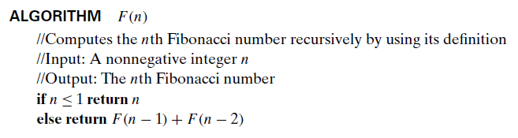
Computing F(n): Brute-Force Approach
To calculate the Fibonacci number, F(n), for an integer n, we can use a brute-force approach of the following pseudo-code.
  Note that we use a recursive function in it.

Slide 5
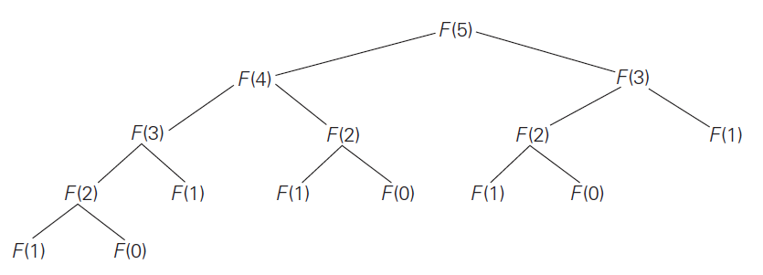
Computing F(n): Brute-Force Approach
A drawback of the recursive algorithm is that we have too many overlapped function calls.
  For example, if we call F(5), the algorithm must calculate F(0) three times and F(1) five times.

Slide 6
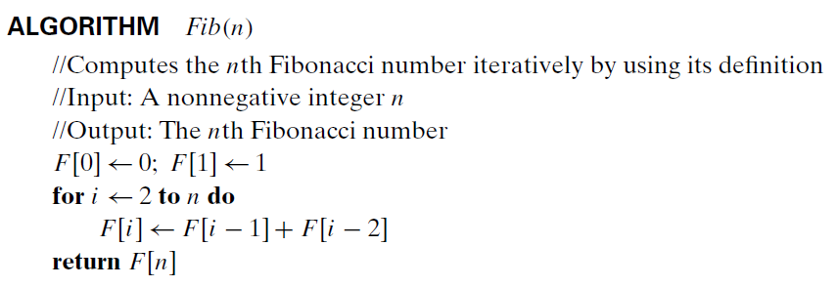
Computing F(n): Dynamic Programming
We can compute F(n) using “iteration and record (= dynamic programming)” approach.
  To avoid multiple calls for a sub-problem, we use an array to keep solutions of sub-problems.
  Pay attention to the “for” loop in the code.

